Slide 1

CS2009 Design and Analysis of Algorithms
Approximate Algorithms for NPC Problems

Slide 2
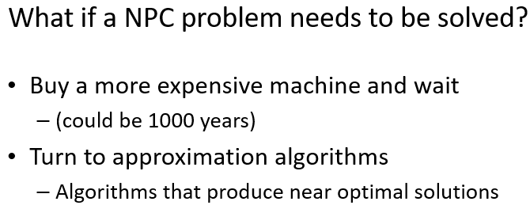
Approximate Algorithms for NPC Problems

Slide 3
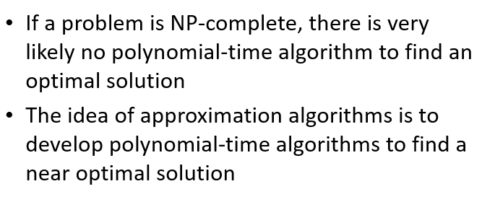
Approximate Algorithms for NPC Problems

Slide 4
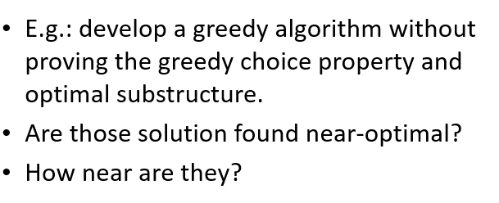
Approximate Algorithms for NPC Problems

Slide 5
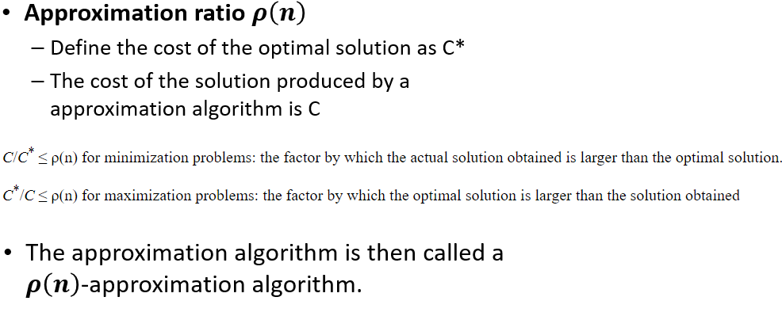
Approximate Algorithms for NPC Problems

Slide 6
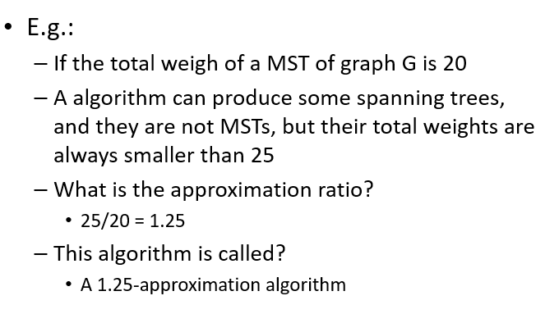
Approximate Algorithms for NPC Problems

Slide 7
Approximate Algorithms for NPC Problems
MST is a minimization problem as we need to minimize distance so the approximate ratio = C/C*
The maximization problem is a problem where we need to maximize something like the robot maximize reward question given in mid2 where we need to maximize reward, unlike MST. In that case, the approximate ratio = C*/C
In short approximate ratio will be greater than 1 as an approximate algorithm is near optimal which means it is not better than optimal.

Slide 8
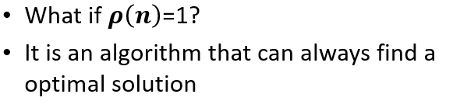
Approximate Algorithms for NPC Problems

Slide 9
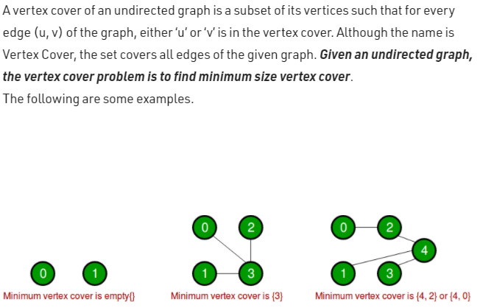
2-approximation algorithm for Vertex Cover
A 2-approximation algorithm returns a solution whose cost is at most twice the optimal
Vertex Cover Problem (NP-Complete Problem) :

Slide 10
2-approximation algorithm for Vertex Cover
1
2
3
4
5
6
7
Are the dark brown vertices a vertex-cover?
No. why?
Edges (5, 6), (3, 6) and (3, 7) are not covered by it

Slide 11
2-approximation algorithm for Vertex Cover
1
2
3
4
5
6
7
Are the dark brown vertices a vertex-cover?
No. why?
Edge (3, 7) is not covered by it

Slide 12
2-approximation algorithm for Vertex Cover
1
2
3
4
5
6
7
Are the dark brown vertices a vertex-cover?
Yes
What is the size?
4

Slide 13
2-approximation algorithm for Vertex Cover
1
2
3
4
5
6
7
Are the dark brown vertices a vertex-cover?
Yes
What is the size?
7

Slide 14
2-approximation algorithm for Vertex Cover
1
2
3
4
5
6
7
Are the dark brown vertices a vertex-cover?
Yes
What is the size?
5

Slide 15
2-approximation algorithm for Vertex Cover
1
2
3
4
5
6
7
Are the dark brown vertices a vertex-cover?
Yes
What is the size?
3

Slide 16
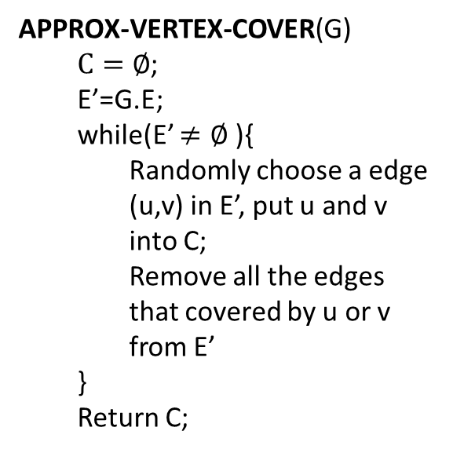
2-approximation algorithm for Vertex Cover
APPROX-VERTEX-COVER(G)
$C=∅$;
E’=G.E;
while(E’ $≠∅$ ){
Randomly choose a edge (u,v) in E’, put u and v into C;
Remove all the edges that covered by u or v from E’
}
Return C;
1
2
3
4
5
6
7

Slide 17
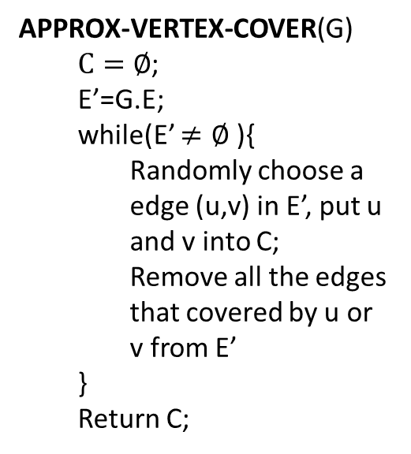
2-approximation algorithm for Vertex Cover
APPROX-VERTEX-COVER(G)
$C=∅$;
E’=G.E;
while(E’ $≠∅$ ){
Randomly choose a edge (u,v) in E’, put u and v into C;
Remove all the edges that covered by u or v from E’
}
Return C;
1
2
3
4
5
6
7
It is then a vertex cover
Approximate cost / optimal cost = 6/3 = 2
Size?
6
How far from optimal one?

Slide 18
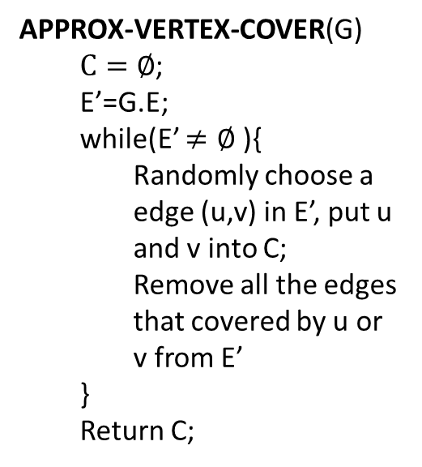
2-approximation algorithm for Vertex Cover
APPROX-VERTEX-COVER(G)
$C=∅$;
E’=G.E;
while(E’ $≠∅$ ){
Randomly choose a edge (u,v) in E’, put u and v into C;
Remove all the edges that covered by u or v from E’
}
Return C;
1
2
3
4
5
6
7

Slide 19
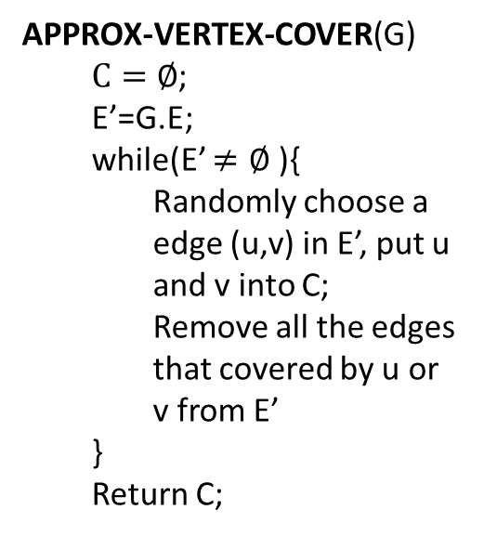
2-approximation algorithm for Vertex Cover
APPROX-VERTEX-COVER(G)
$C=∅$;
E’=G.E;
while(E’ $≠∅$ ){
Randomly choose a edge (u,v) in E’, put u and v into C;
Remove all the edges that covered by u or v from E’
}
Return C;
1
2
3
4
5
6
7
It is then a vertex cover
Size?
4
How far from optimal one?
4/3 = 1.33

Slide 20
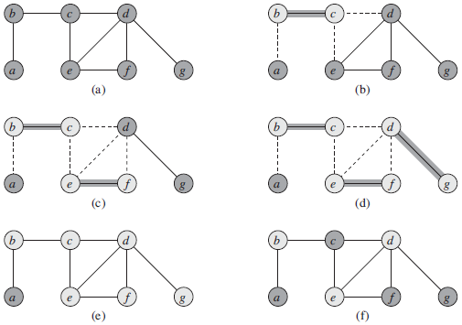
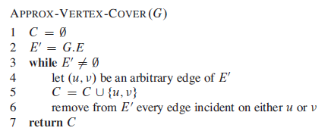
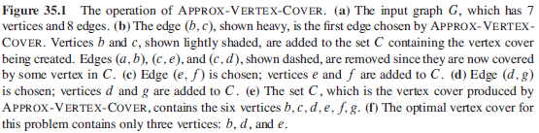
2-approximation algorithm for Vertex Cover

Slide 21
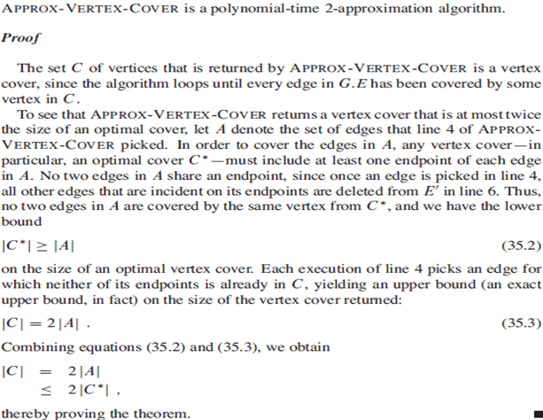
2-approximation algorithm for Vertex Cover

Slide 22

Approximation algorithm for Set-covering problem
Set-covering problem
Given a set X, and a family F of subsets of X, where F covers X, i.e. $X=\bigcup_{S∈F}{S}$.
Find a subset of F that covers X and with minimum size

Slide 23
Approximation algorithm for Set-covering problem
X:
a
b
c
h
d
e
{f1, f3, f4} is a subset of F covering X
F:
{f1, f2, f3, f4} is a subset of F covering X
f1:
a
b
f5:
a
{f2, f3, f4, f5} is a subset of F covering X
f2:
b
f3:
c
h
Here, {f1, f3, f4} is a minimum cover set
f4:
d
e

Slide 24

Approximation algorithm for Set-covering problem
Set-covering problem is NP-complete.
If the size of the largest set in F is m, there is a $\sum_{i=1}^{m}{1/i}$ - approximation polynomial time algorithm to solve it.

Slide 25

Approximation algorithm for Set-covering problem
GREEDY-SET-COVER(X, F)
U=X;
C=$∅;$
While(U$≠$ $∅$){
Select S$∈$F that maximizes |S$∩$U|;
U=U-S;
C=C$⋃${S};
}
return C;

Slide 26
Approximation algorithm for Set-covering problem
We can choose from f1, f3 and f4
X:
Choose f1
a
b
c
h
We can choose from f3 and f4
Choose f3
We can choose from f4
d
e
Choose f4
F:
f1:
a
b
a
b
c
h
d
e
U:
f2:
b
f3:
c
h
C:
f1:
a
b
f4:
d
e
f3:
c
h
f5:
a
f4:
d
e

Slide 27
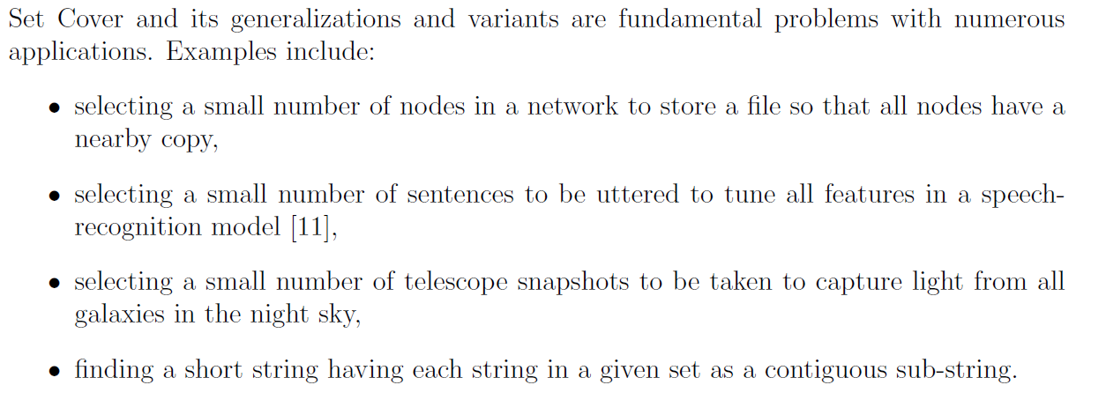
Approximation algorithm for Set-covering problem

Slide 28
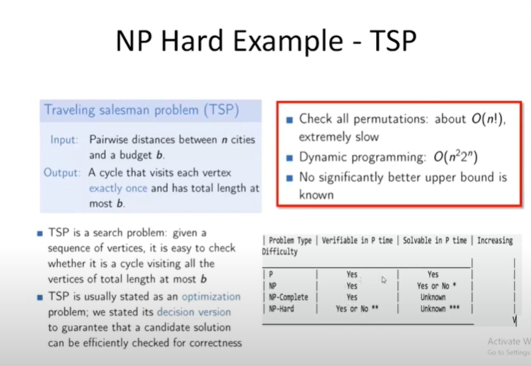

Slide 29
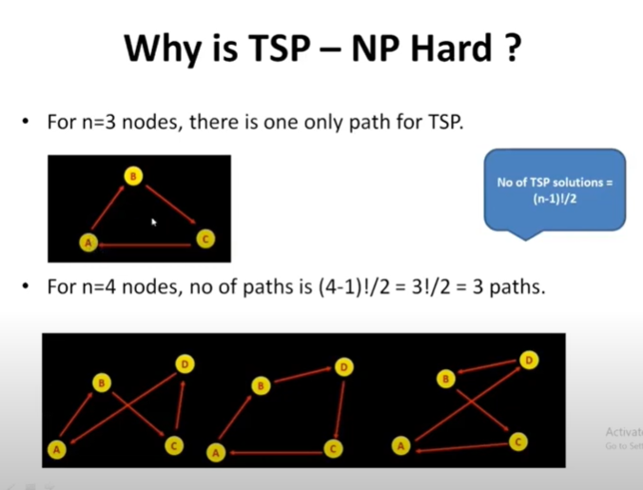

Slide 30
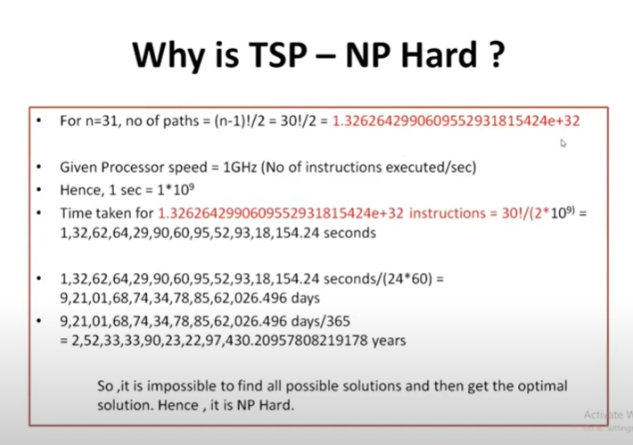

Slide 31
Approximation algorithm for Traveling-salesman problem
Traveling-salesman problem (TSP):
Given a weighted, undirected graph, start from certain vertex, find a minimum route visit each vertices once, and return to the original vertex.
1
1
2
30
2
1
20
3
4
3

Slide 32
Approximation algorithm for Traveling-salesman problem
TSP is a NP-complete problem
There is no polynomial-time approximation algorithm with a constant approximation ratio
Another strategy to solve NPC problem:
Solve a special case

Slide 33
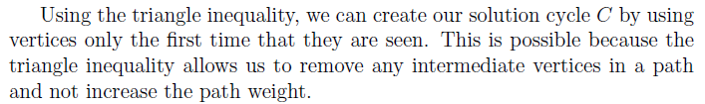
Approximation algorithm for Traveling-salesman problem
Triangle inequality:
Weight(u, v) <= Weight(u, w) + Weight(w, v)
E.g.:
If all the edges are defined as the distance on a 2D map, the triangle inequality is true
For the TSPs where the triangle inequality is true:
There is a 2-approximation polynomial time algorithm

Slide 34
Approximation algorithm for Traveling-salesman problem
APPROX-TSP-TOUR(G)
Find a MST m;
Choose a vertex as root r;
return preorderTreeWalk(m, r);

Slide 35
Approximation algorithm for Traveling-salesman problem
Can we apply the approximation algorithm on this one?
1
1
2
30
2
1
20
3
4
3
No. The triangle inequality is violated.

Slide 36
Approximation algorithm for Traveling-salesman problem
Use Prim’s algorithm to get a MST
a
d
e
b
f
g
c
h
For any pair of vertices, there is a edge and the weight is the Euclidean distance
Triangle inequality is true, we can apply the approximation algorithm

Slide 37
Approximation algorithm for Traveling-salesman problem
Use Prim’s algorithm to get a MST
a
d
Choose “a” as the root
e
b
f
g
Preorder tree walk
c
a
b
c
h
d
e
f
g
h
For any pair of vertices, there is a edge and the weight is the Euclidean distance
Triangle inequality is true, we can apply the approximation algorithm

Slide 38
Approximation algorithm for Traveling-salesman problem
Use Prim’s algorithm to get a MST
a
d
Choose “a” as the root
e
b
f
g
Preorder tree walk
c
a
b
c
h
d
e
f
g
h
The route is then…
Because it is a 2-approximation algorithm
A TSP solution is found, and the total weight is at most twice as much as the optimal one

